Slide 1
When to use and when not to use BBR:
An empirical analysis and evaluation study
Yi Cao, Arpit Jain, Kriti Sharma, Aruna Balasubramanian, and Anshul Gandhi
Department of Computer Science, Stony Brook University

Slide 2
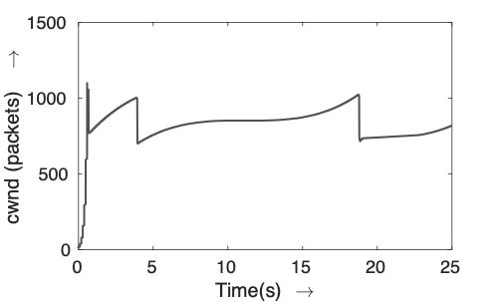
Introduction of BBR (1/2)
Traditional TCP algorithms are loss-based
  Linux’s default TCP Algorithm — CUBIC
  Reduces the throughput by 30% when a loss occur
Loss might not be a good congestion signal
  Shallow buffer: Misinterprets the congestion
  Deep buffer: Bufferbloat
Packet Loss
Tx ↓30%
Evolution of CUBIC’s Throughput
Packet Loss
Bufferbloat
Shallow Buffer
Deep Buffer

Slide 3
Introduction of BBR (2/2)
Google proposed BBR in 2016
  Instead of using packet losses at congestion signals
  Relies on measured Bandwidth and RTT
  TCP pacing: Inter-packet spacing
BBR already used in Google Cloud and YouTube
Max
BW
x
Min
RTT
BDP
x
2
cwnd
Bandwidth-Delay Product
Congestion Window Size
Packet k
Packet k+1
Pacing
Spacing

Slide 4
Motivation for BBR Evaluation
Before adopting BBR, it is important to answer:
  When is BBR useful?
  What is the downside of ignoring packet losses?
  Is BBR unfair to loss-based algorithms?
Prior works
  Unfairness issue – ICNP 2017 (Hock et al.)
  Very few buffer sizes, or a single testbed
  High packet retransmissions – IFIP 2018 (Scholz et al.), ITC 2018 (Hurtig et al.)
  No reasoning behind huge loss
Goal of our work:
Show when BBR is useful + Reveal root causes

Slide 5

Experimental Setup
Deploying traffic controller on the router for fine-grained control
  Set bandwidth, delay and buffer size
  Linux Traffic Control (TC) – NetEm, Token Bucket Filter (TBF)
Experimental Networks
  Mininet — Virtual Network (40µs RTT)
  LAN (40µs RTT), WAN (7ms RTT)
Sender
Receiver
Linux Traffic Control
(Token Bucket Filter)

Slide 6
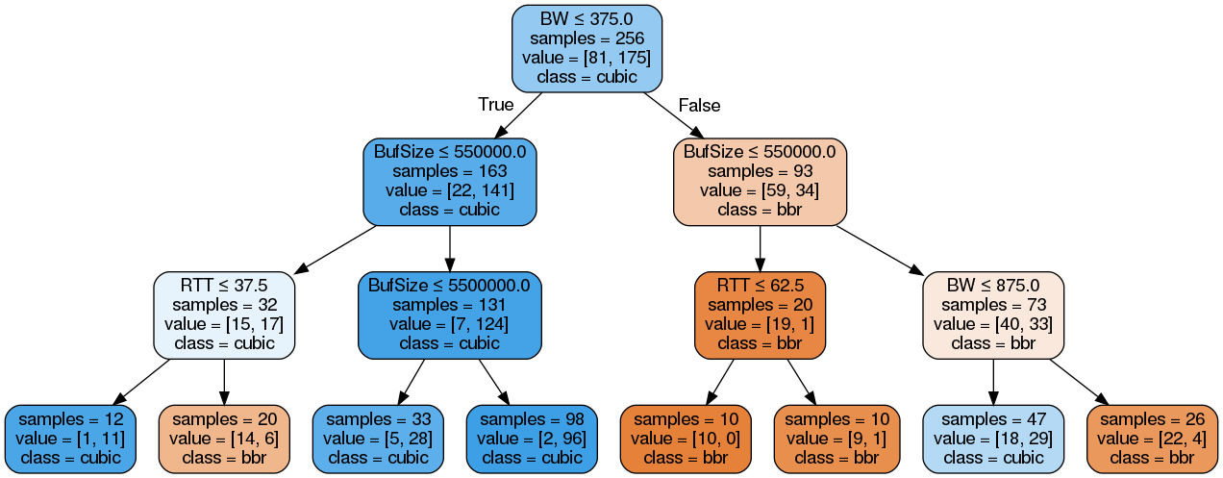


Decision Tree
Goodput – BBR vs CUBIC
  640 iPerf3 transfers (1min) in the LAN network
  We generalize the goodput values by a decision tree
Network Configuration
Cubic
BBR
BDP — Bandwidth x Delay
Small BDP, Deep Buffer
CUBIC > BBR
Large BDP, Shallow Buffer
BBR > CUBIC

Slide 7

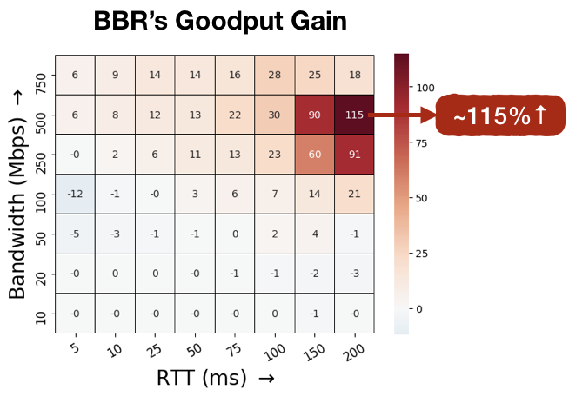
Q1) When is BBR Useful
BBR has significantly higher goodput than CUBIC in shallow buffers
  Focus on shallow buffer (100KB)
  We define goodput improvement:
BBR Ignore Losses
 | BBR | CUBIC
Congestion Signal | BW, RTT | Loss

Slide 8
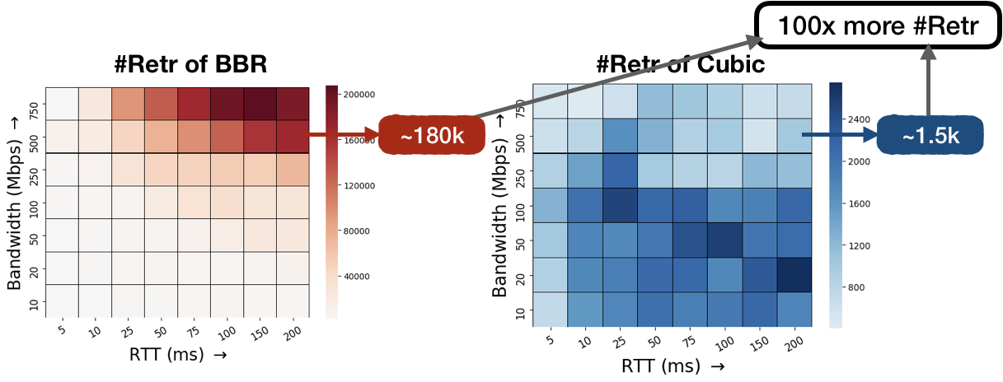
Q2) What is the Downside of Ignoring Losses
BBR incurs huge packet losses in shallow buffers
  BBR keeps 2BDP data in the network
BBR provides high goodput but at the expense of high packet retransmissions

Slide 9
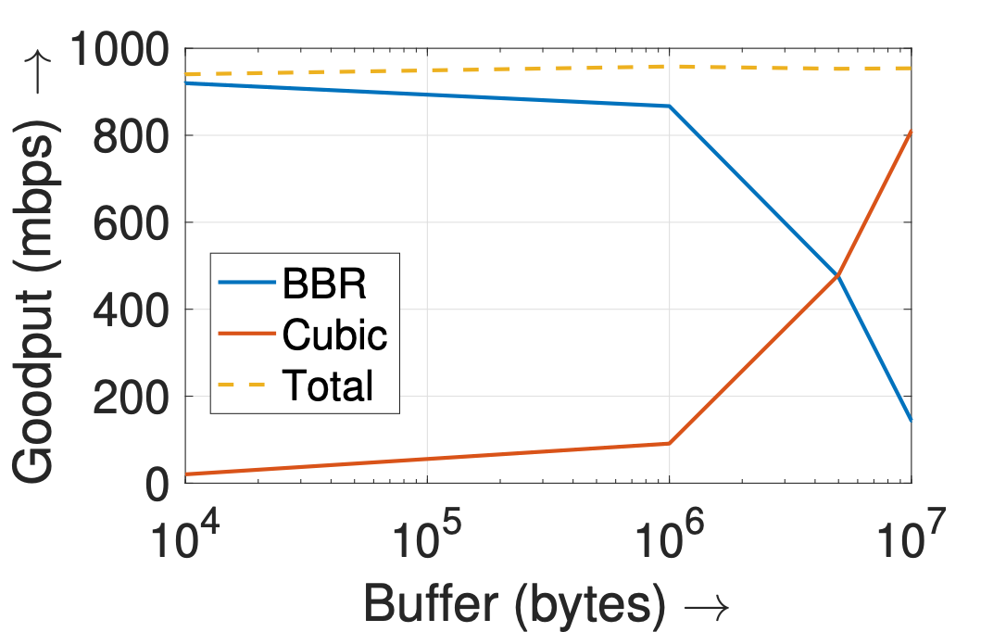
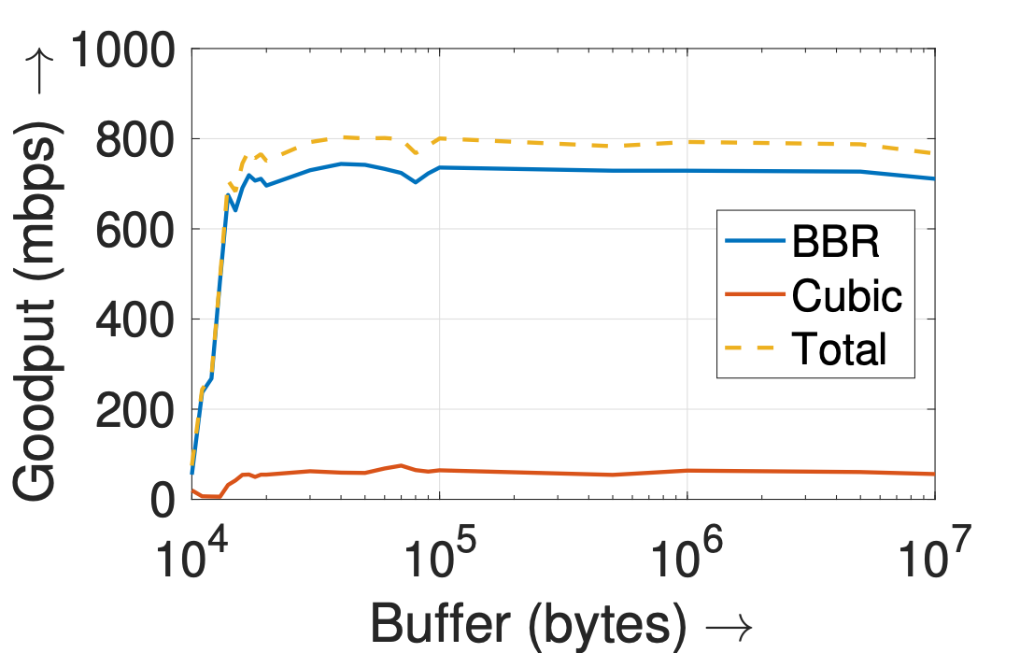

Q3) Is BBR Unfair to Loss-based Algorithms?
Mininet (BW:1Gbps, RTT:20ms)
BBR and CUBIC are unfair in different buffer sizes
  Run BBR and CUBIC concurrently in Mininet
  Shallow buffer: BBR higher share
  Deep buffer: CUBIC higher share
Different behavior in WAN network
  BW stabilizes at 20KB – Indicates bottleneck buffer in the wild
BBR
Better
CUBIC
Better
BBR
Receiver
WAN Results
Different
Buffer sizes
CUBIC
Stabilizes at 20KB
Unfairness between BBR and CUBIC depends on the bottleneck buffer size

Slide 10
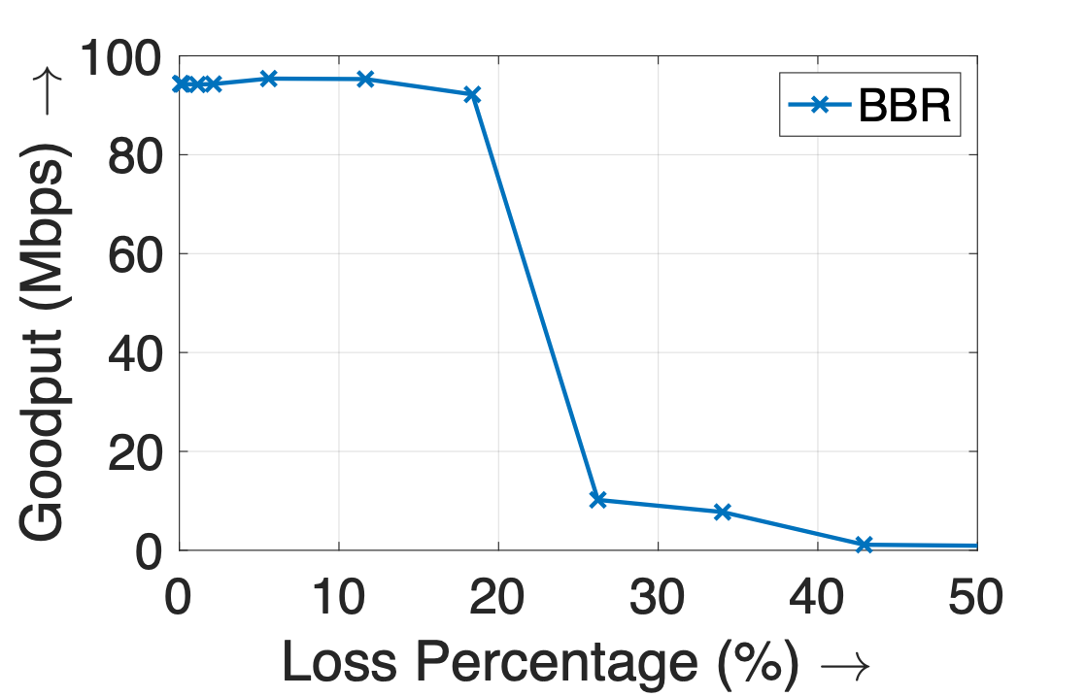
Cliff Point Root-Cause Analysis
Cliff Point
  Abrupt drop in goodput when loss rate reaches 20%
  Our analysis: max_pacing_gain is the culprit
  Scaling factor to probe for more bandwidth
Cliff Point
BW
max_pacing_gain
Determines
100Mbps
x
1.25
success rate
Mininet: 100Mbps BW, 25ms RTT, 10MB Buffer
125Mbps
x
< 80%
< 100Mbps
Throughput
Cliff point = 1 – 1/max_pacing_gain
Actual BW
The max_pacing_gain parameter is the root cause for the goodput “cliff point”

Slide 11
BBR Evaluation Summary
BBR is an emerging TCP variant
    Not loss-based
    Insufficient evaluations
Takeaways
    In terms of goodput, BBR is well suited for networks with shallow buffers, despite its high retransmissions
    Unfairness between BBR and Cubic depends on the bottleneck buffer size
    The maximum pacing_gain parameter is the root cause for the goodput “cliff point”
For future work
    Enable auto-tuning for BBR parameters to avoid high retransmissions and maintain fairness
  We are actively investigating BBR v2

